Slide 1
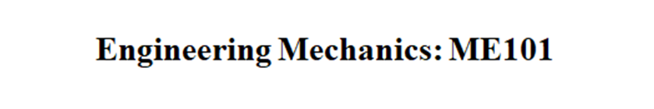
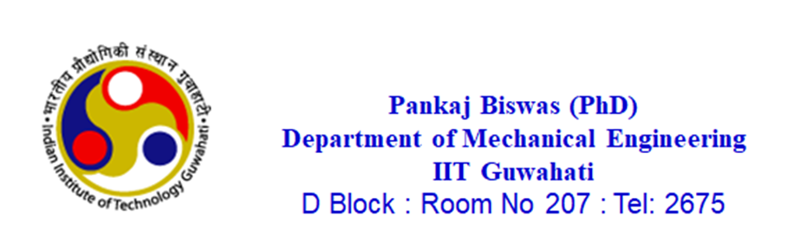

Slide 2
VVI NOTE ON PROBLEM:
If force and movement direction are same then the workdone is (+) ve.
If force and movement direction are opposite then the workdone is (-) ve.
But here the total workdone is consider as positive and then derivative of displacement is done. So due to this derivation it automatically changed to actual + ve or – ve value as per point 1 and 2.
So two way we can do it, first find the magnitude of small displacement then according to direction of force and displacement put the sign of workdone.

Slide 3
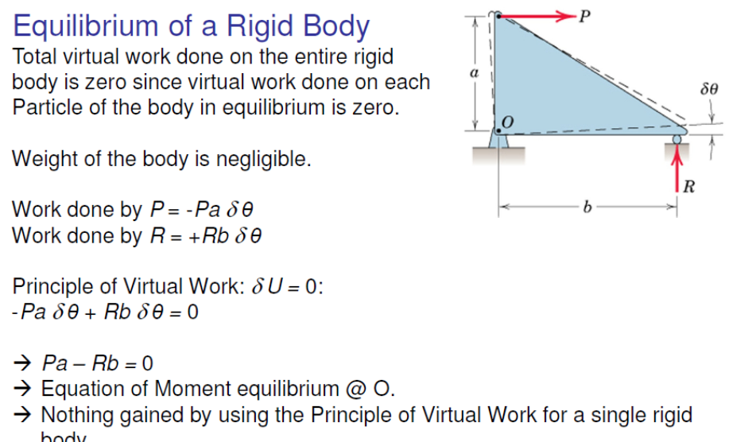
Applications of Principle of Virtual Work

Slide 4
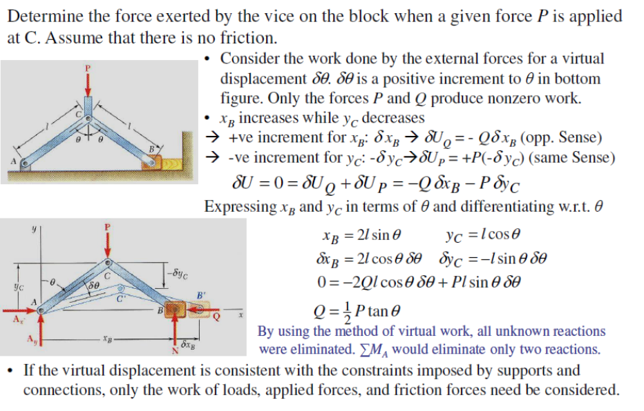
Problem 1
Note: If the force and displacement direction are opposite then (-)ve work done.

Slide 5
Principle of Virtual Work (contd.)

Slide 6
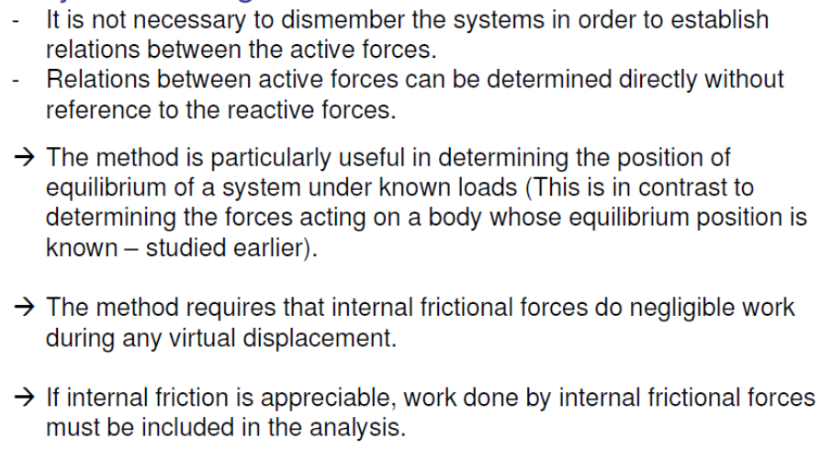
Major Advantages of Virtual Work Method

Slide 7
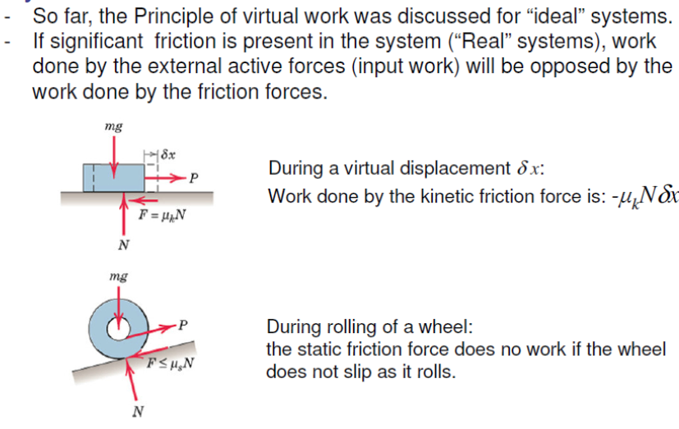
Principle of Virtual Work application to systems having Friction

Slide 8
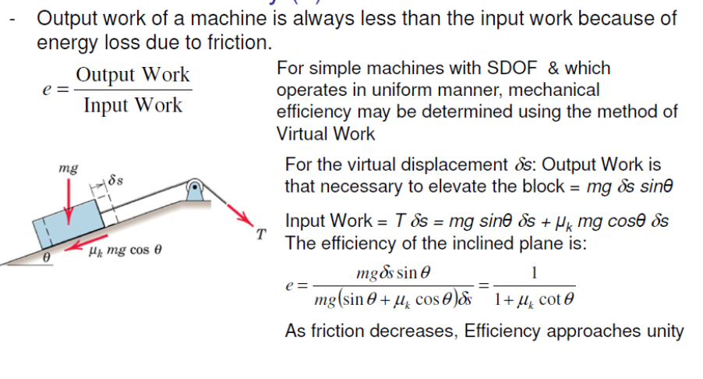
Mechanical Efficiency(e)

Slide 10
Problem 2

Slide 11
Problem 2 (contd.)

Slide 12
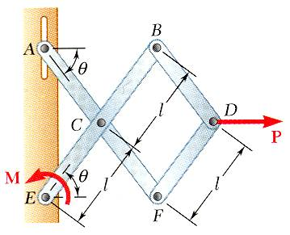
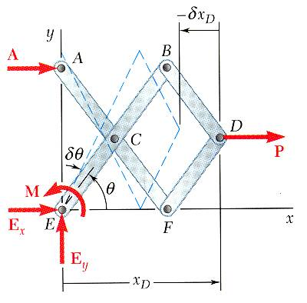
Problem 3
Determine the magnitude of the couple M required to maintain the equilibrium of the mechanism shown in Fig(a)?
SOLUTION:
Apply the principle of virtual work,
Fig(a)

Slide 13
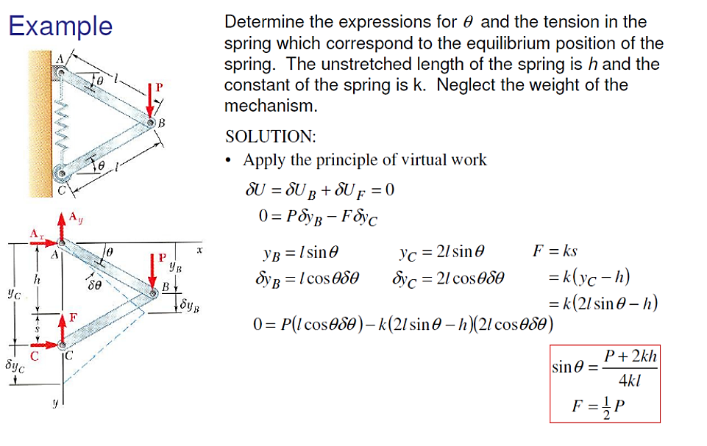
Problem 4

Slide 14
Problem 5

Slide 15
Problem 5 (contd.)

Slide 16
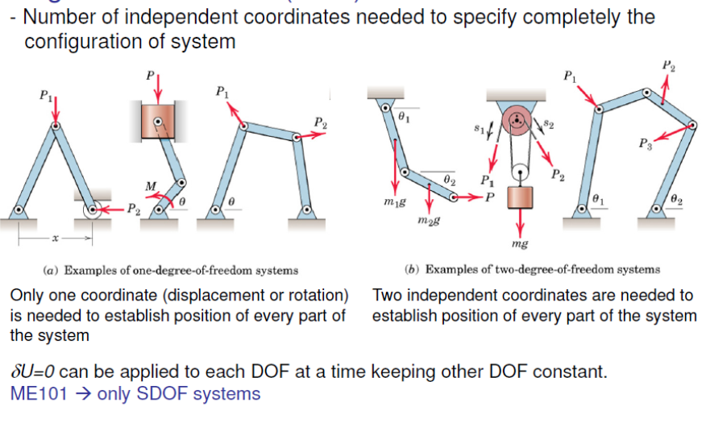
Degrees of Freedom (DOF)

Slide 17
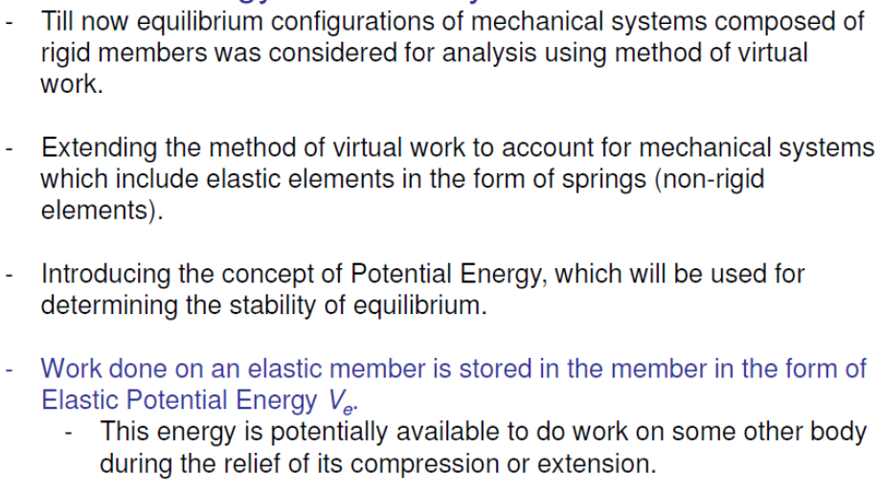
Potential Energy & Stability

Slide 19
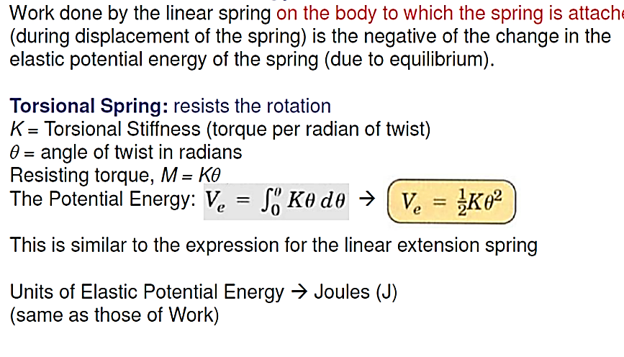
Elastic Potential Energy of Torsional Spring
Note: If the spring is compressed then the energy is stored in spring. This is (+) ve energy in spring.
So, the work done on the body should be (–)ve of spring stored energy. In Virtual work technique, we should consider the energy on the body not the spring.

Slide 20
Note: Here weight is downward always.
So if it move upward then work done will be (–)ve.
20

Slide 21
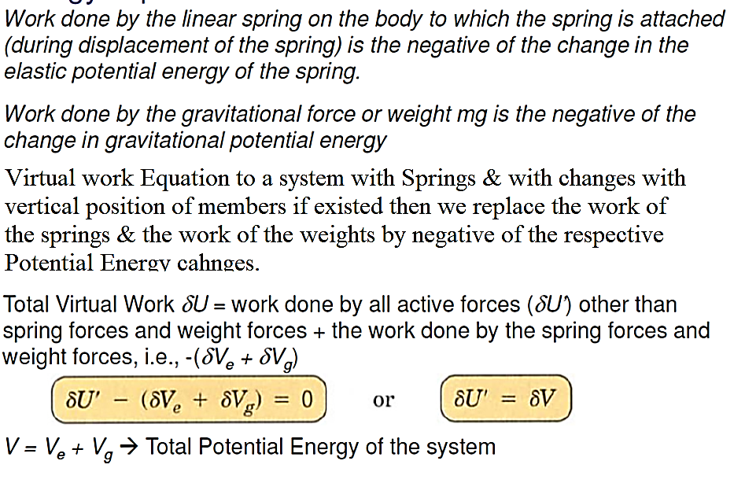
Energy Equation
Note: Workdone on the body is equal and opposite to the elastic energy stored in the spring. In spring once compression takes place then it is called (+) energy stored in the spring. But this workdone will be (-) on the body.
21

Slide 22
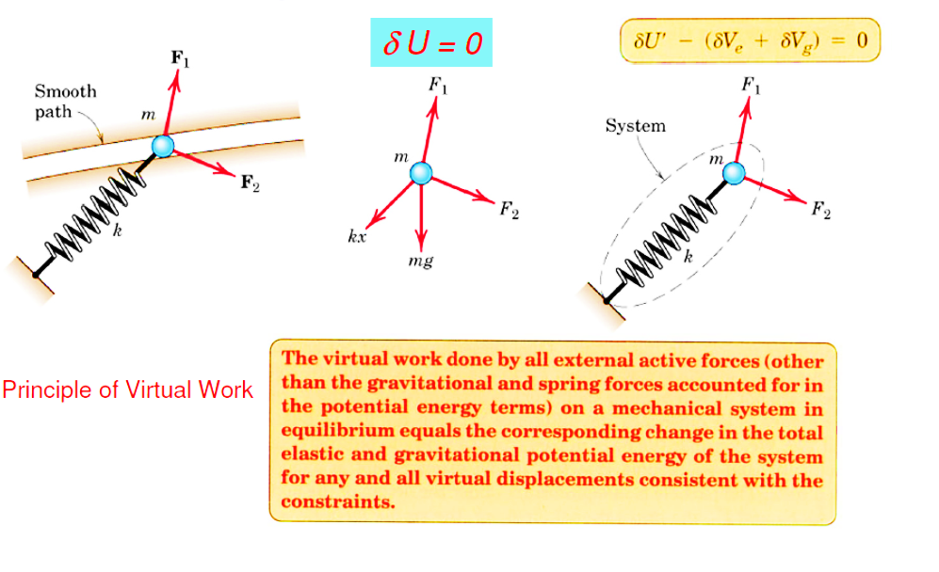
Active Force diagrams
22

Slide 23
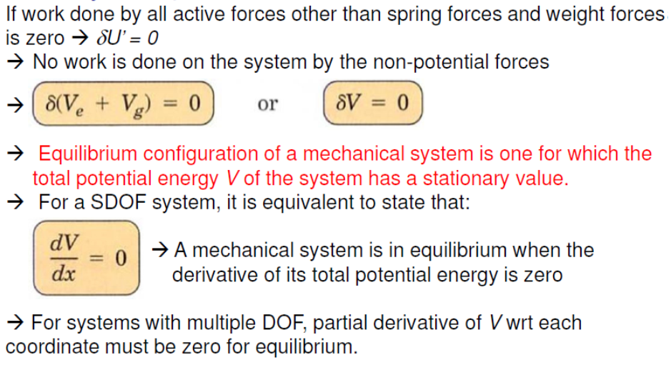
Stability of Equilibrium
23

Slide 24
24

Slide 25
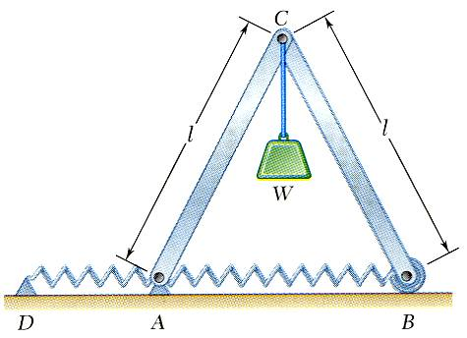
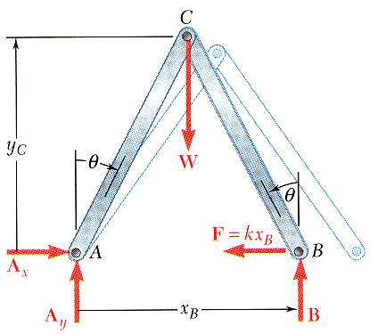
Problem on Potential Energy & Equilibrium
For the structure shown,
Note: Above datum Whatever the work of weight that should be +ve.
Always we have to measure the distance from the datum.
When the potential energy of a system is known, the principle of virtual work becomes
At the position of equilibrium,
indicating two positions of equilibrium.
25

Slide 26
Problem 6
26

Slide 27
Problem 6 (contd.)
27

Slide 28
Problem 8
28

Slide 29
Problem 8 (contd.)
29

Slide 30
Problem 8 (contd.)
30

Slide 31
Problem 8 (contd.)
31

Slide 32
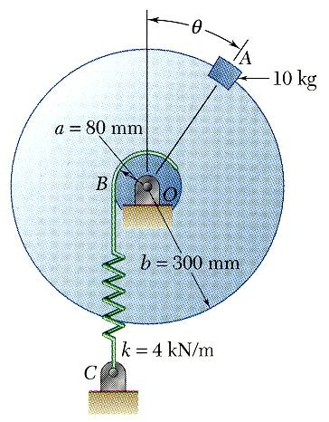
Sample Problem 9
SOLUTION:
Derive an expression for the total potential energy of the system.
Determine the positions of equilibrium by setting the derivative of the potential energy to zero.
Evaluate the stability of the equilibrium positions by determining the sign of the second derivative of the potential energy.
Knowing that the spring BC is unstretched when θ = 0, determine the position or positions of equilibrium and state whether the equilibrium is stable, unstable, or neutral.
?
32

Slide 33
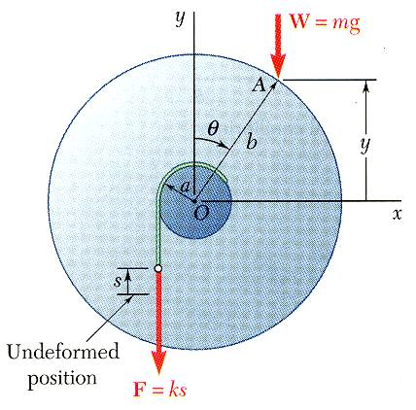
Problem 9 (contd.)
SOLUTION:
Derive an expression for the total potential energy of the system.
Determine the positions of equilibrium by setting the derivative of the potential energy to zero.
33

Slide 34
Problem 9 (contd.)
Evaluate the stability of the equilibrium positions by determining the sign of the second derivative of the potential energy.
at θ = 0:
unstable
at θ = 51.7º:
stable
34

Slide 35
Problem 10
35

Slide 37
Problem 10 (contd.)
37

Slide 38
Problem 10 (contd.)
38

Slide 39
Problem 11
39

Slide 40
Problem 11 (contd.)
40

Slide 41
Problem 11 (contd.)
41

Slide 42
Problem 12
42

Slide 43
Problem 12 (contd.)
43

Slide 44
Problem 12 (contd.)
44

Slide 45
END

Slide 46
Problem 7

Slide 47
Problem 7 (contd.)
Note: As though the spring is compressed but the direction of force and movement are opposite to each other that’s why
the potential energy in the spring is (-)ve. But the potential energy for virtual work is (+) ve. Here spring base is moving not front.

Slide 48
Problem 7 (contd.)

Slide 49
Assignments

Slide 51


